Slide 1

The Source Matters:
Media Literacy in the Age of Fake News
Kim George and Bev Van Note

Slide 2
What do we mean by
“fake news”?
An introduction to the issue

Slide 3
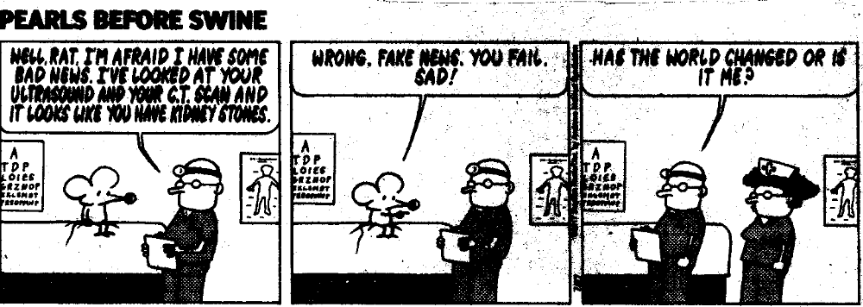
The term “fake News” is everywhere
Austin American-Statesman, 27 Jul. 2017

Slide 4

Would you Believe this headline?
"Pope Francis shocks world, endorses Donald Trump for president“ (originally published by WTO5 News)
Giampiero Sposito | Reuters
Pope Francis
In Ritchie, ‘‘Read All About It,’’ CNBC.com

Slide 5
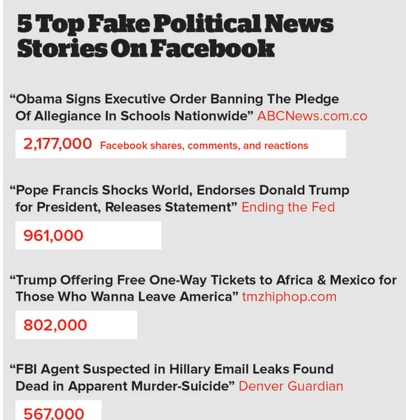

Slide 6
Defining “FAKE” News
Fake news is NOT:
an error in reporting (usually corrected within a short period of time).
a bias in reporting.
news you don’t like to hear because it says something different than what you believe.
Fake news is:
news that is made up, false, not true.
news that pretends to be from one source but is really from another.

Slide 7
How good are you at identifying fake news?
Try this quiz:
  http://factitious.augamestudio.com/#/

Slide 8
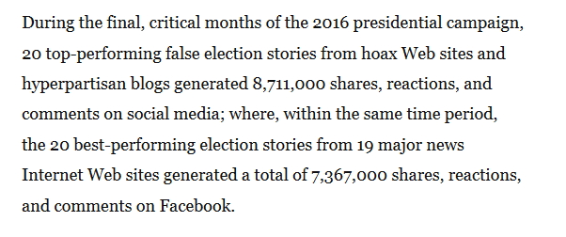
Why does it matter?
Source: a newly-presented state law in California that asks for media literacy education written by Sen. Dodd

Slide 9
Why does it matter for our students?
2016 Stanford study shows “stunning and dismaying” lack of ability. Researchers say, “in every case and at every level, we were taken aback by students’ lack of preparation” (Donald).
Michael P. Lynch says, “The Internet is both the world’s best fact-checker and the world’s best bias-confirmer—often at the same time.” (Stanford History Education Group).
Students lack critical thinking skills with regard to online content.

Slide 10
Evaluating Reliability of an online source
a Step-by-step method

Slide 11
Evaluating reliability
STEP 1: Look at the URL.
Does the URL make sense?
Does the URL address/name of the website seem biased? (GunsforAmerica.org or goneleft.org probably are biased groups)
Does the URL have “wordpress” or “blogger” in the address? If so, this will be a blog, will have little editorial supervision, and will also most likely represent opinions over facts. If the article states “Opinion” or “Perspective” next to it, this will be opinion-based.

Slide 12
Evaluating reliability
STEP 2: Look at the source/article itself.
Who is the author? Does he/she have a bias?
Is there a reliance in the writing on facts rather than opinions?
Is the article current? Recent?

Slide 13
Evaluating reliability step 3: Examine other sources.
Are other known/reputable news sites reporting on the story? There should typically be more than one reputable source reporting on a topic or event.
Are there links and references to other sources listed? If so, are these links and sources reliable? Look up the sources. Is the information being accurately reflected and reported? Are officials being cited? Can you confirm their quotes elsewhere? Some media literacy and critical scholars call this triangulation: Verify details, facts, quotes, etc. with multiple sources.

Slide 14
Evaluating Reliability step 4: Research “About Us” or “Contact Us.”
Google every title/domain name/anyone listed in the “About Us” section to see if anyone has previously reported on the website (Snopes, Politifact, Factcheck.org, etc.) or whether it has a Wikipedia page detailing its background. Be aware that reading the site’s “About Us” link may or may not be true. Information provided in Google may provide more truthful information.
Look for information about the credentials and backgrounds of writers. Are there editors? Publishers? Who pays them? Who runs the website? Is there a legal disclaimer section that would reveal if the site is a satirical website like The Onion?
Realize that if there is no information “about us” or if no individual authors are ever listed on the news source, this most likely is a source you want to skip.

Slide 15
Evaluating reliability
Step 5: analyze the STYLE.
Are there numerous grammatical and spelling errors?
Are there ALL CAPS in the headlines or in the body text?
Does the headline have loaded language or words intended to shock or create emotion? This may be click-bait, intended to get the reader to click on the link and create advertising money.
Does the language of the headline or article include slang?
IF you discover the answer to any of the above questions is “yes,” you probably want to find another source.

Slide 16
Evaluating Reliability
STEP 6: analyze the DESIGN and advertising.
Look at the design of the page. Does the page look professional?
Examine the advertisements along the side of the page. How do these fit with the source of the article?
Determine if links work. Or determine if they are “under construction” or no longer operational? If they aren’t, question the integrity of the source.

Slide 17
Evaluating reliability
Step 7: analyze the diction and pathos.
If the story makes you really angry or fearful, find another source.
If the story makes you extremely sad or worried, find another source.
If the source include lots of loaded language with strongly emotional language, find another source.
Any story that includes much pathos-building is probably less reliable and is intended to create emotion. While this is not necessarily bad, be sure that the article is not trying to get you to share in order to generate ad revenue. Find other sources that help provide a more even balance of fact and emotion.

Slide 18
Evaluating reliability
Step 8: complete a reverse image search.
Make sure that the picture posted has not been altered, has not had a date change, has not had the wrong attribution given, or does not misrepresent the truth. Many fake news writers use pictures already taken and reattribute them.
How do you do this? Right click on the image and save image location. Go to Google Images and click on the camera. Paste the image location in the box. See what shows up in the search results. Are there articles about the image alteration? Are there articles about the original source of the photo?

Slide 19
Evaluating reliability
BEST TIP: read multiple sources.
Read multiple sources of information to get a variety of viewpoints and media frames. “Sources such as The Daily Kos, The Huffington Post, and Fox News vacillate between providing important, legitimate, problematic, and/or hyperbolic news coverage, requiring readers and viewers to verify and contextualize information with other sources” (Melissa Zimdars)

Slide 20
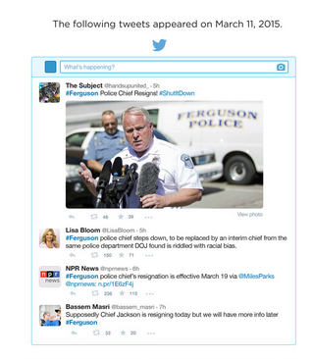
Let’s Try it. Which is the most reliable tweet?

Slide 21
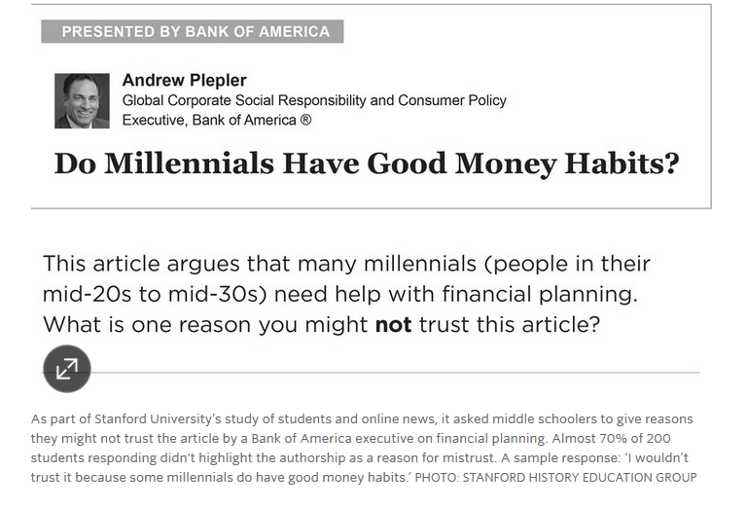
Let’s Try It #2. Is this an article you want to read for unbiased financial guidance?

Slide 22
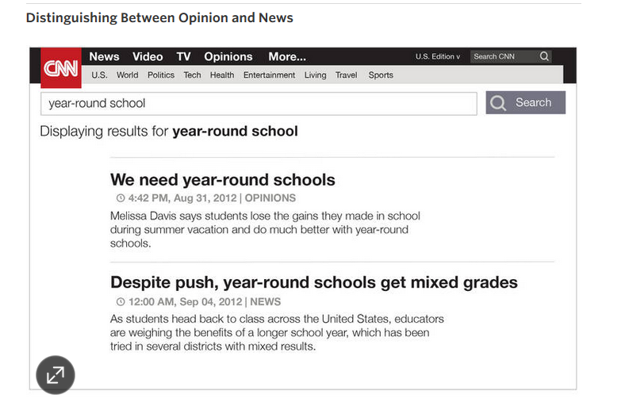
Let’s Try it #3. Which article is more reliable?

Slide 23
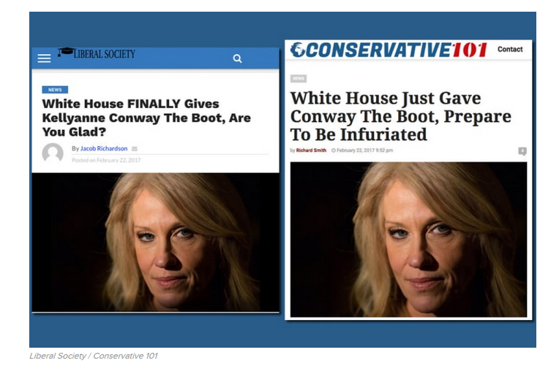
Let’s Try it #4. Which article is more reliable? What do you notice about the 2 articles?

Slide 24
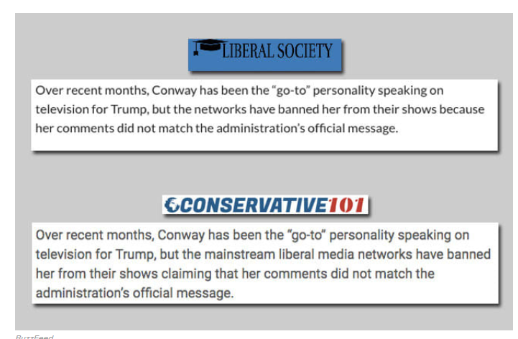
In one: “Kellyanne Conway has been a terrible communications director for Donald Trump.”
In the other: “Kellyanne Conway has been the go-to communications director for Donald Trump.”
Both articles included the same tweets from Conway and MSNBC host Mika Brzezinski.
“Liberal Society, Democratic Review, and God Today all have the same Google Analytics ID in their source code, which means they are connected. Conservative 101 and American News have the same Google AdSense ID and domain records show that the latter is also registered to American News LLC.”
Source: Craig Silverman, “This Is How Your Hyperpartisan Political News Gets Made”

Slide 25
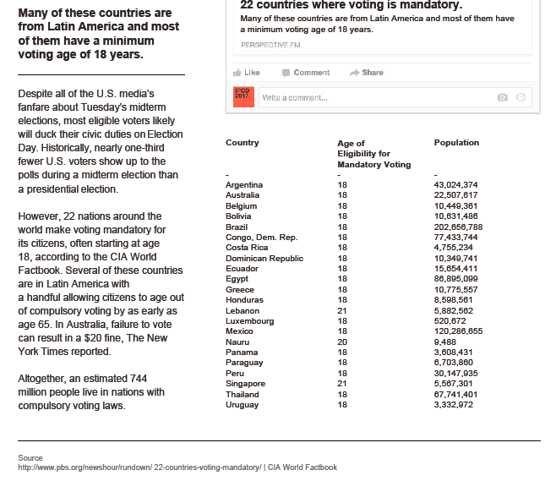
Let’s Try #5. Is this article reliable? Why or why not?

Slide 26
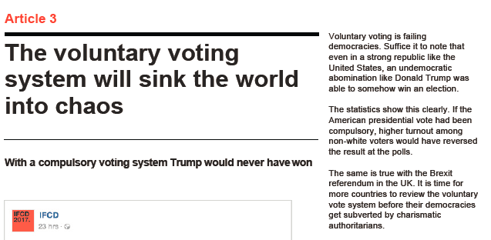
Let’s Try
#6.
Is this article reliable? Why or why not?

Slide 27
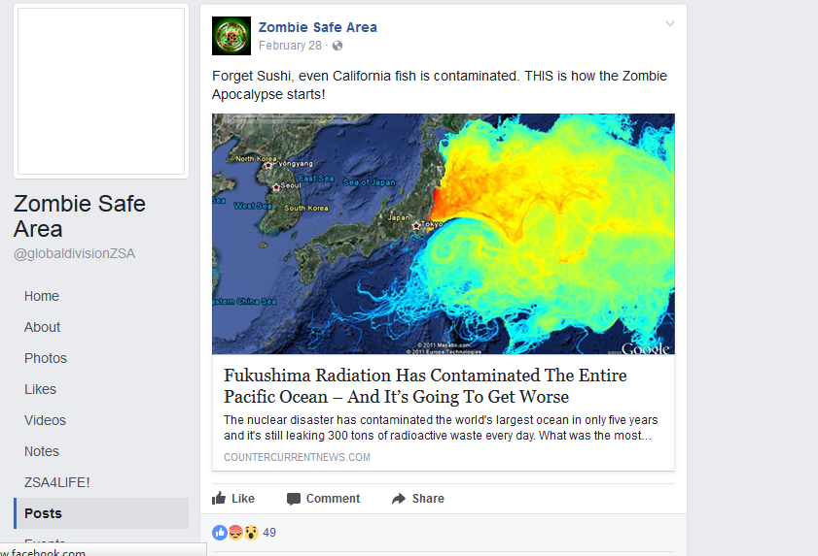
ONE MORE LOOK at fake news:
https://goo.gl/TX4XYq

Slide 28
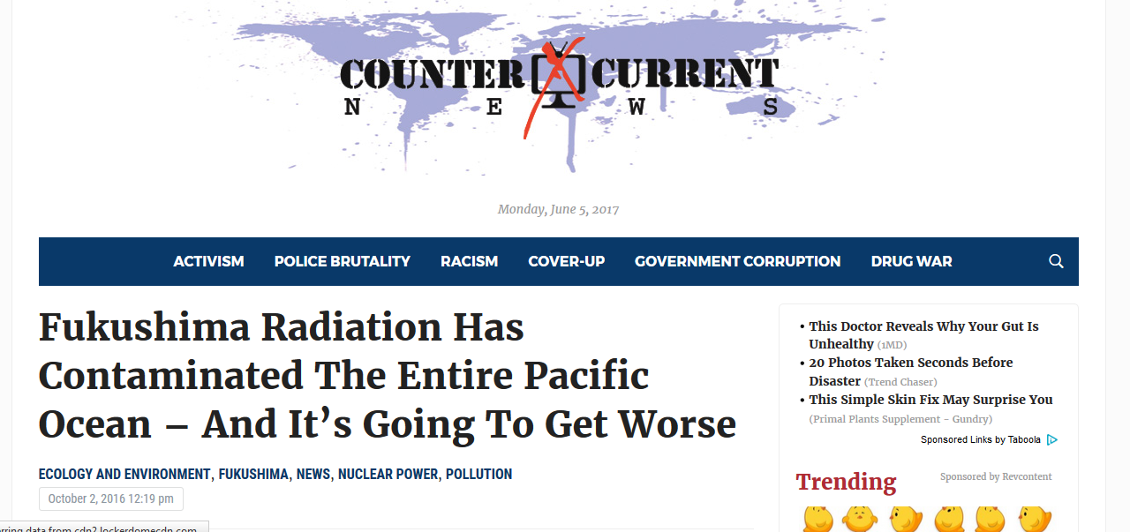
A link to the article
https://goo.gl/ioqxHh

Slide 29
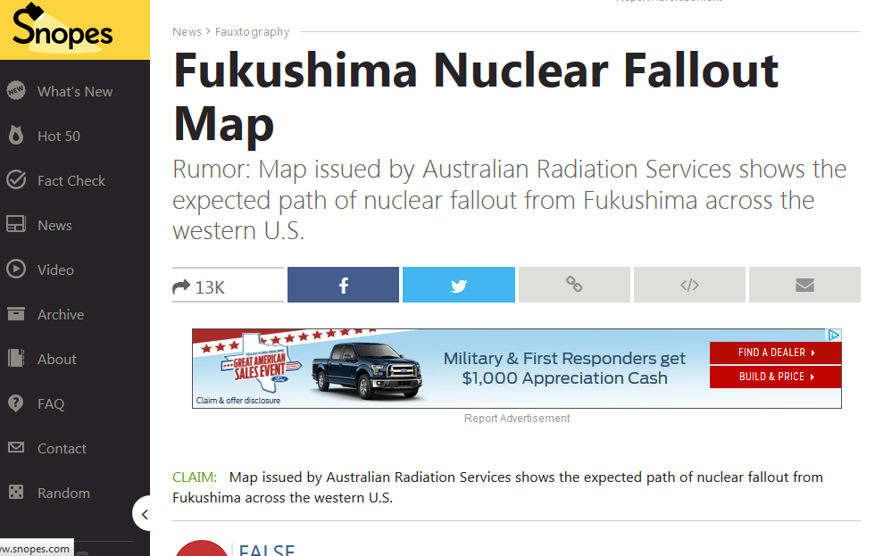
A Look at Snopes: (after doing a reverse image search on the radiation image from article on slide 31)
http://www.snopes.com/photos/technology/fallout.asp

Slide 30
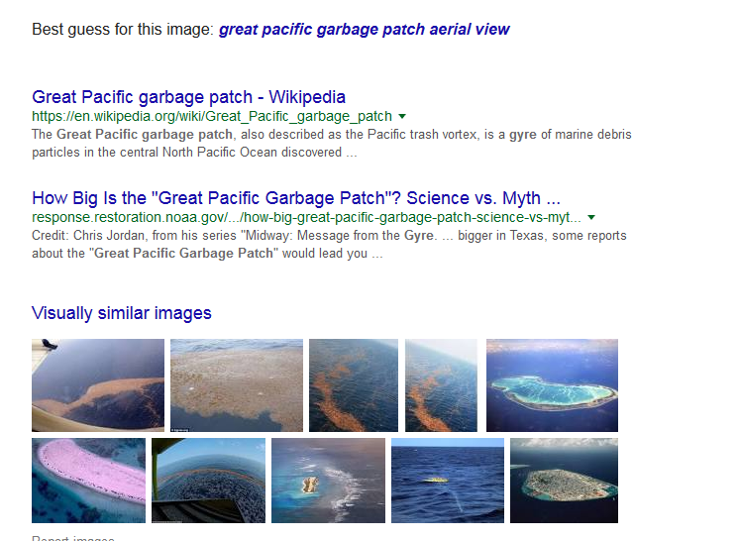
Reverse image search on the other picture of radiation fallout from the article on slide 31

Slide 31
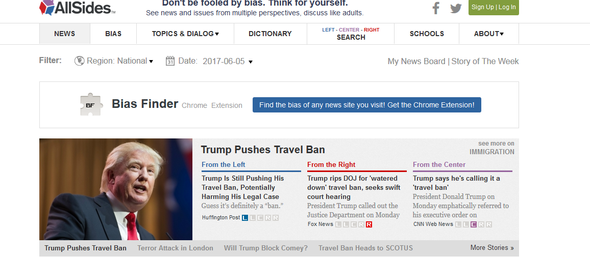
Where CAN I go to check out myths or find reliable sources?
www.Allsides.com
List of 10 reliable sources: The New York Times, The Wall Street Journal, The Washington Post, BBC, The Economist, The New Yorker, Politico, Foreign Affairs, The Atlantic, and wire services like Reuters, Associated Press, Bloomberg News. https://www.forbes.com/sites/berlinschoolofcreativeleadership/2017/02/01/10-journalism-brands-where-you-will-find-real-facts-rather-than-alternative-facts/amp/

Slide 32
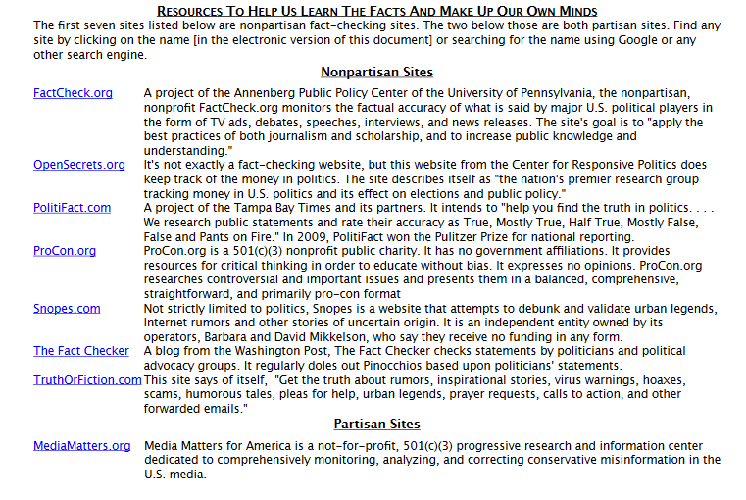

Slide 33
One more Example:
Fox News borrows from a tabloid that borrows from a Russian news story that borrows from a fake Facebook post that borrows from a satirical article
https://www.nytimes.com/interactive/2017/06/07/world/europe/anatomy-of-fake-news-russian-propaganda.html?smid=fb-nytimes&smtyp=cur&_r=0

Slide 34
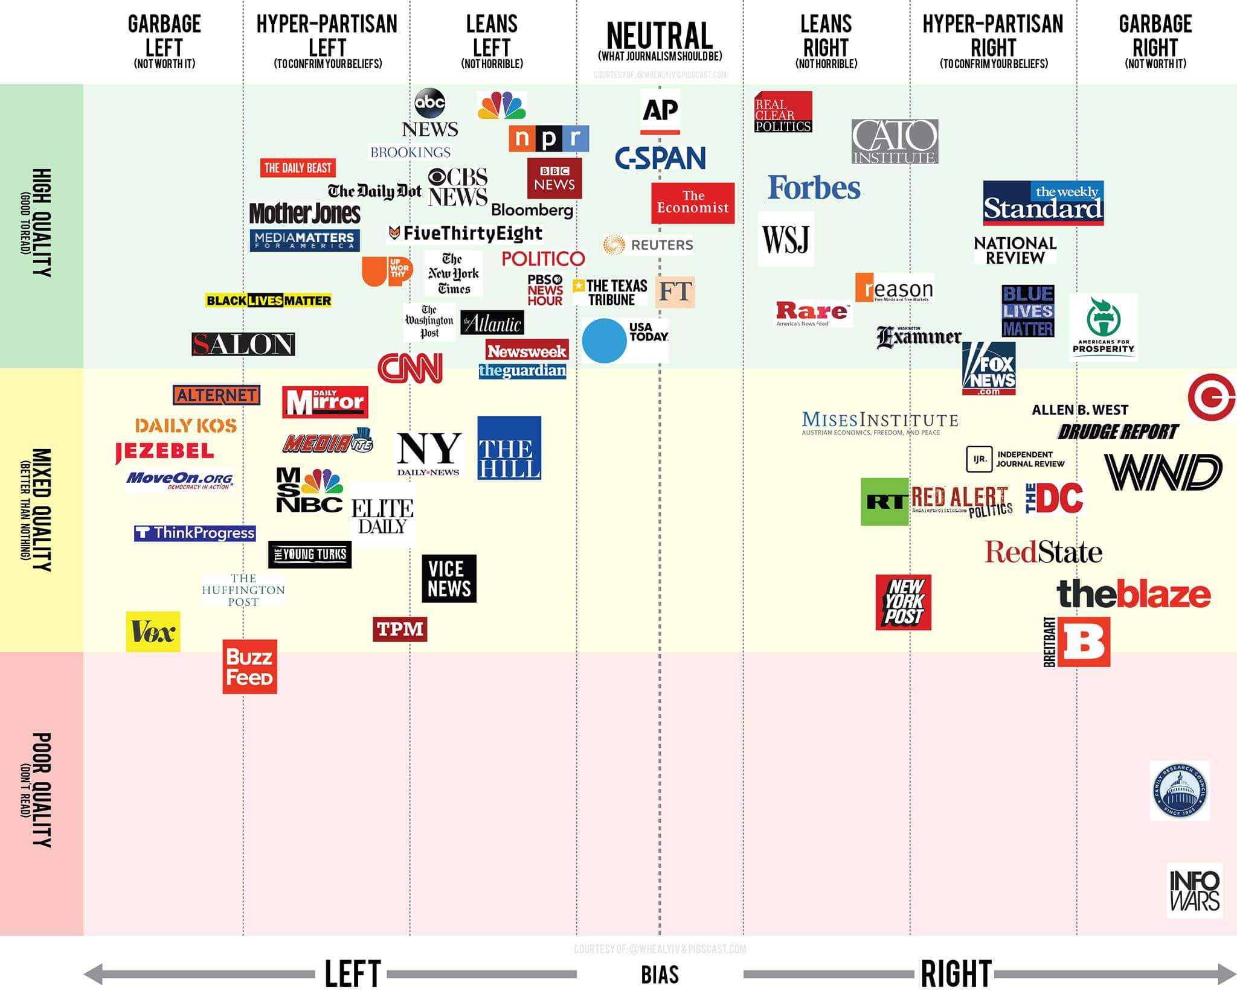

Slide 35
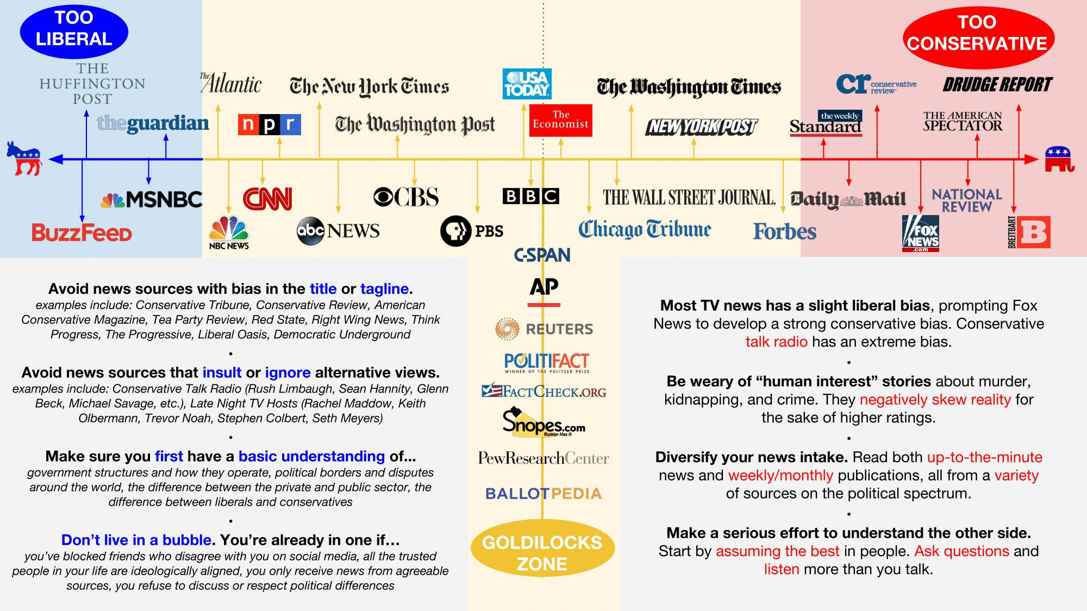

Slide 36
How can I teach media literacy?
Some ideas to get you started

Slide 37
Suggested activities
1) Article Evaluation: In an open web search, students decide if a website can be trusted.
2) Research a Claim: Students search online to verify a claim about a controversial topic.
3) Website Reliability: Students determine whether a partisan site is trustworthy.
4) Social Media Video: Students watch an online video and identify its strengths and weaknesses.
5) Claims on Social Media: Students read a tweet and explain why it might or might not be a useful source of information.
Source: Stanford History education group

Slide 38

English
Analyze rhetoric and/or evidence in an op-ed piece or an editorial cartoon.
Evaluate an online source for research writing.
Evaluate evidence from several sources for writing an argument.

Slide 39

Social sciences
Investigate the mix of fact and fiction in two popular sites on the Holocaust.
Trace the spread of misinformation about “Pizzagate” or some other popular fake news story. (See Aisch, Huang, and Kang)
Create a backtrack journal in which students trace the path of something interesting that shows up on their screens before it got to them. (See Revkin)

Slide 40

Math, Sciences, health
Explore use of median and mean in two online reports offering statistics on the same issue, e.g., rate of teen pregnancy in Texas.
Analyze the use of bar graphs or pie charts in offering information to support a specific controversial claim.
Evaluate and compare three articles on the same controversial topic, e.g., the effect of environment on honeybees (see Grossman), polar melt, or talcum powder as a potential carcinogen.

Slide 41

business
Compare two online sources of information about the removal of the United Airlines passenger in April to analyze customer relations practices.
Choose a recent business controversy, such as the United passenger removal or the accusations of illegal antiquities fraud trading by Hobby Lobby owners, and analyze responses to these incidents on a particular social media platform.
Evaluate web site design. (also useful in fine arts classes)

Slide 42
sources
@Channel4News. “Want to help stop fake news from spreading. Here’s three simple ways (via @FactCheck.” Twitter, 17 Feb. 2017, 7:49 a.m., https://twitter.com/channel4news/status/832618082153676800
“2017 International Fact-Checking Day Lesson Plan.” Poynter, 2017, http://factcheckingday.com/lesson-plan
Aisch, Gregor, Jon Huang, and Cecilia Kang. “Dissecting the #Pizzagate Conspiracy Theories.” New York Times, 10 Dec. 2016, https://www.nytimes.com/interactive/2016/12/10/business/media/pizzagate.html
Colglazier, William. “The Best Tips for Spotting Fake News in the Age of Trump.” Teen Vogue, 17 Jan. 2017, http://www.teenvogue.com/story/the-best-tips-for-spotting-fake-news-in-the-age-of-trump
Domonoske, Camila. “Students Have ‘Dismaying’ Inability to Tell Fake News from Real, Study Finds.” NPR, 23 Nov. 2016, http://www.npr.org/sections/thetwo-way/2016/11/23/503129818/study-finds-students-have-dismaying-inability-to-tell-fake-news-from-real
Donald, Brooke. “Stanford Researchers Find Students Have Trouble Judging the Credibility of Information Online.” Stanford Graduate School of Education, 22 Nov. 2016, https://ed.stanford.edu/news/stanford-researchers-find-students-have-trouble-judging-credibility-information-online
FactCheck.org. “How to Spot Fake News.” 8 Dec. 2016, https://www.youtube.com/watch?v=AkwWcHekMdo#action=share
Grossman, Kelly. “Lesson Plan: Evaluating Sources.” 15 Feb. 2015, https://www.carli.illinois.edu/sites/files/pub_serv/ICForum150618GrossmannHandout.pdf

Slide 43
Sources continued
Lynch, Michael P. “Googling is Believing: Trumping the Informed Citizen.” New York Times, 9 Mar. 2016, https://opinionator.blogs.nytimes.com/2016/03/09/googling-is-believing-trumping-the-informed-citizen/
“Milo Yiannopoulos.” Wikipedia, https://en.wikipedia.org/wiki/Milo_Yiannopoulos
Pastis, Stephan. “Pearls Before Swine.” Austin American-Statesman, 27 Jul. 2017.
Revkin, Andy. “Tools and Techniques for Tracking How #FakeNews (or the Real Thing) Flows.” Medium, 23 Aug. 2016, https://medium.com/@revkin/to-see-how-information-flows-online-try-a-backtrack-journal-e5e65e56bf6c
Ritchie, Hannah. “Read All About It: The Biggest Fake News Stories of 2016.” CNBC, 30 Dec. 2016, https://www.cnbc.com/2016/12/30/read-all-about-it-the-biggest-fake-news-stories-of-2016.html
Silverman, Craig. “This Is How Your Hyperpartisan News Gets Made.” BuzzFeed News, 27 Feb. 2017, https://www.buzzfeed.com/craigsilverman/how-the-hyperpartisan-sausage-is-made?bffbnews&utm_term=.etrRk6YBr#.oan51b3Zm
Stanford History Education Group. “Evaluating Information: The Cornerstone of Civic Online Reasoning.” SHEG, https://sheg.stanford.edu/upload/V3LessonPlans/Executive%20Summary%2011.21.16.pdf
Zimdars, Melissa. “False, misleading, Clickbait-y, and Satirical ‘News’ Sources.” http://creativecommons.org/licenses/by/4.0/ .

Slide 44
Additional resources
Association of College and Research Libraries. “Framework for Information Literacy for Higher Education.” American library association, 11 Jan. 2016, http://www.ala.org/acrl/standards/ilframework
The news literacy project. The News literacy project, 2017, http://www.thenewsliteracyproject.org/
Revkin, Andrew C. “An Exercise to Sift for Sources Amid a Blitz of Fake News.” New York Times, 24 Nov. 2016, https://dotearth.blogs.nytimes.com/2016/11/24/an-exercise-to-sift-for-sources-amid-a-blitz-of-fake-news/
Schulten, Katherine, and Amanda Christy Brown. “Evaluating Sources in a ‘Post-Truth’ World: Ideas for Teaching and Learning about Fake News.” New York Times, 19 Jan. 2017, https://www.nytimes.com/2017/01/19/learning/lesson-plans/evaluating-sources-in-a-post-truth-world-ideas-for-teaching-and-learning-about-fake-news.html

